Slide 1
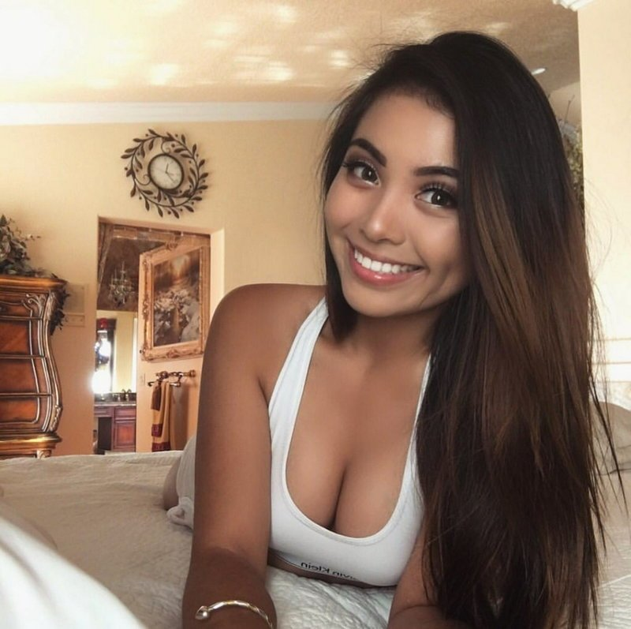
MY ID:9210-2237-0192
Show your now
OPEN PAGE
unsubscribe

